Slide 1



Sentiment Analysis Using NLP
Data Science Case Study
MIT World Peace University, SY B.Tech ECE (AI-ML)
Shwetha Iyer (PA-25)
Aarushi Gupta (PA-70) Ayushi Sachan (PA-53)

Slide 2
Contents
01
02
03
04
05
06
07
Overview
Understanding the Dataset
Text Pre-processing
Feature Extraction
NLP Techniques
Results
Challenges

Slide 3

Overview

Slide 4

What is NLP?
It is a branch of AI that helps computers process and understand natural language.
It combines linguistics with statistics, ML and DL.
It has applications in machine translation, search engines, sentiment analysis, question-answering, digital assistants like Alexa and Siri, etc.

Slide 5

Sentiment Analysis
It involves interpretation and classification of human emotions/opinions.
It is used to determine public sentiment from consumer reviews of products and services.
It is also used to analyse social media posts to discover consumer insights or to identify signs of mental illness.
In this project, we performed sentiment analysis on IMDB reviews to understand the overall opinion of the movie or TV show from the text.

Slide 6
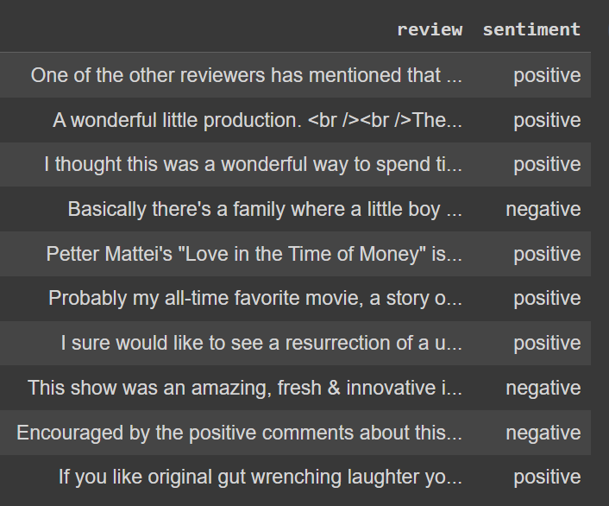
Understanding the Dataset
The CSV file used contains 50,000 rows of movie reviews from IMDB. There are two columns: ‘review’, which contains the review in the form of text, and ‘sentiment’, which categorizes the review as having a positive or negative sentiment. First, this sentiment must be converted to a binary classification for our convenience.

Slide 7
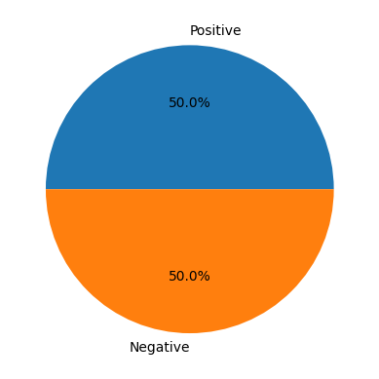
On inspecting the dataset, it is found that positive and negative reviews are evenly distributed.

Slide 8
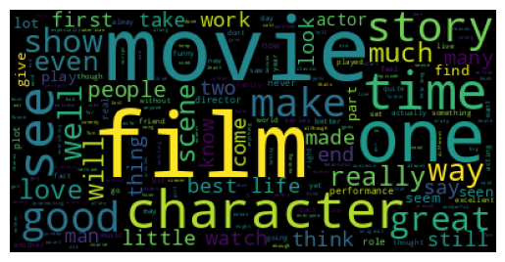
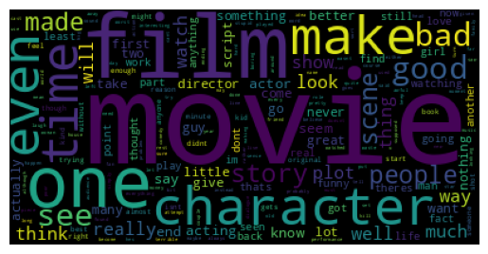
Words associated with positive reviews
There are some other words that are common to both positive and negative reviews, such as ‘movie’, ‘film’, ‘see’, ‘make’, ‘character’, ‘good’, etc.
Words associated with negative reviews
Both positive and negative reviews have ‘one’ as a recurrent word, which might be due to reviews like “One of the best characters/ movies/films/scripts I’ve ever seen” or “One of the worst characters/movies/films/scripts I’ve ever seen”.

Slide 9
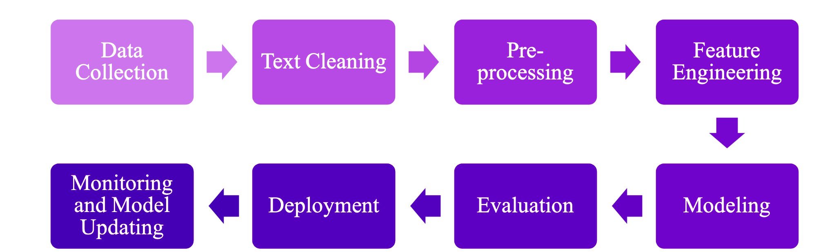
NLP Pipeline:

Slide 10
Text Pre-processing
The text must be pre-processed into a format that the model can understand.
Lower-Casing
Tokenization
Noise Removal
The text is converted to lowercase.
The text is broken into tokens (e.g. words).
Punctuation, special characters, HTML markups, etc. are removed.
Stemming
Lemmatizing
Stopword Removal
Words are reduced to their stem word.
Words are reduced to their base form, which has meaning.
Words with little significance like ‘the’, ‘and’, etc. are removed.

Slide 11
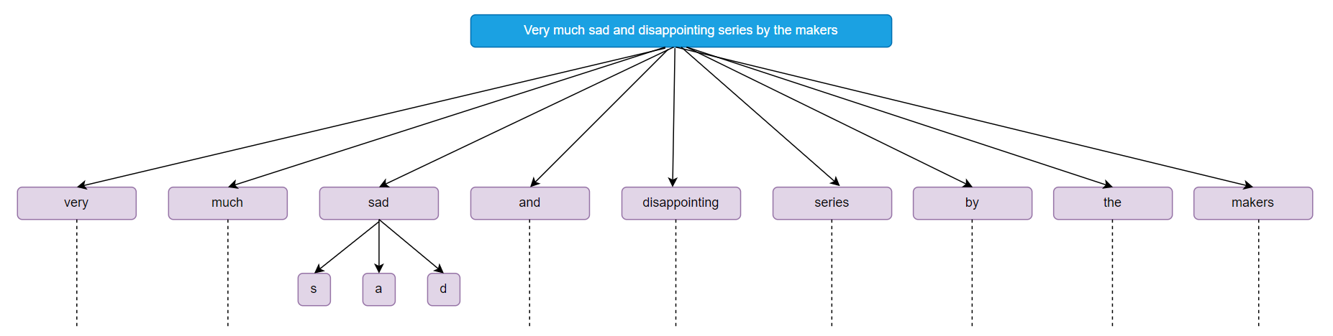
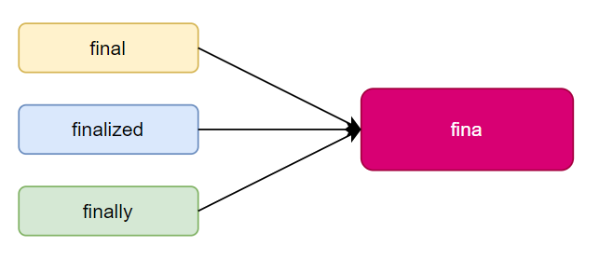
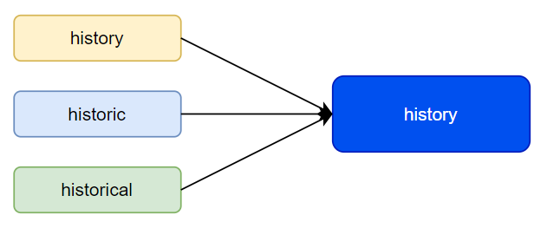
Tokenization:
Stemming:
Lemmatizing:
Source: https://techgenizer.netlify.app/blog/2021/03/16/tokenization-stemming-lemmatization/

Slide 12
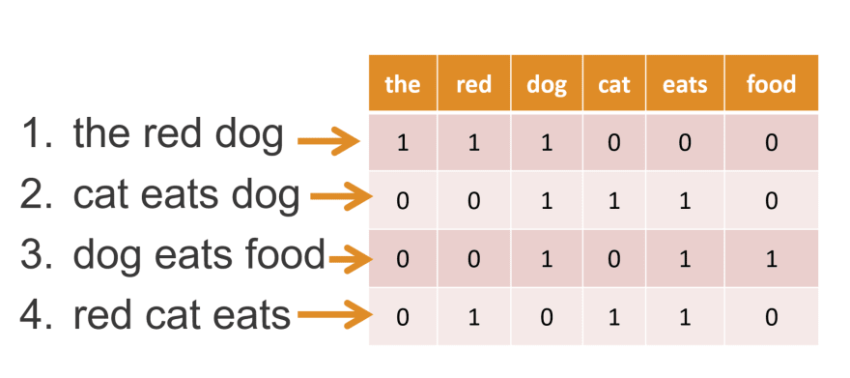
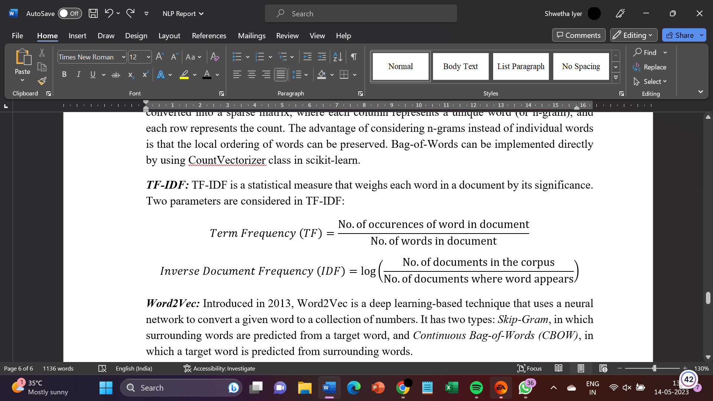
Feature Extraction
Text data needs to be converted into the form of numerical data.
Bag-of-Words
TF-IDF
The text is converted to a sparse matrix based on the frequency of each word or each n-gram of words.
This weighs each word of the document based on its significance, using two parameters: TF and IDF.
Source: https://www.kaggle.com/code/samuelcortinhas/nlp3-bag-of-words-and-similarity

Slide 13
Word2Vec
This is a deep learning-based technique that uses a neural network to generate a word embedding.
These embeddings capture context and semantic meaning.
Word2Vec has two types:
Skip-Gram: surrounding words are predicted from a target word.
Continuous Bag-of-Words (CBOW): target word is predicted from surrounding words.
GloVe
It is similar to Word2Vec, but it generates embeddings by using matrix factorization techniques instead of neural learning.
Its advantage is that it does not just rely on local contexts, but also incorporates global statistics (like counts of word-to-word co-occurrence).

Slide 14
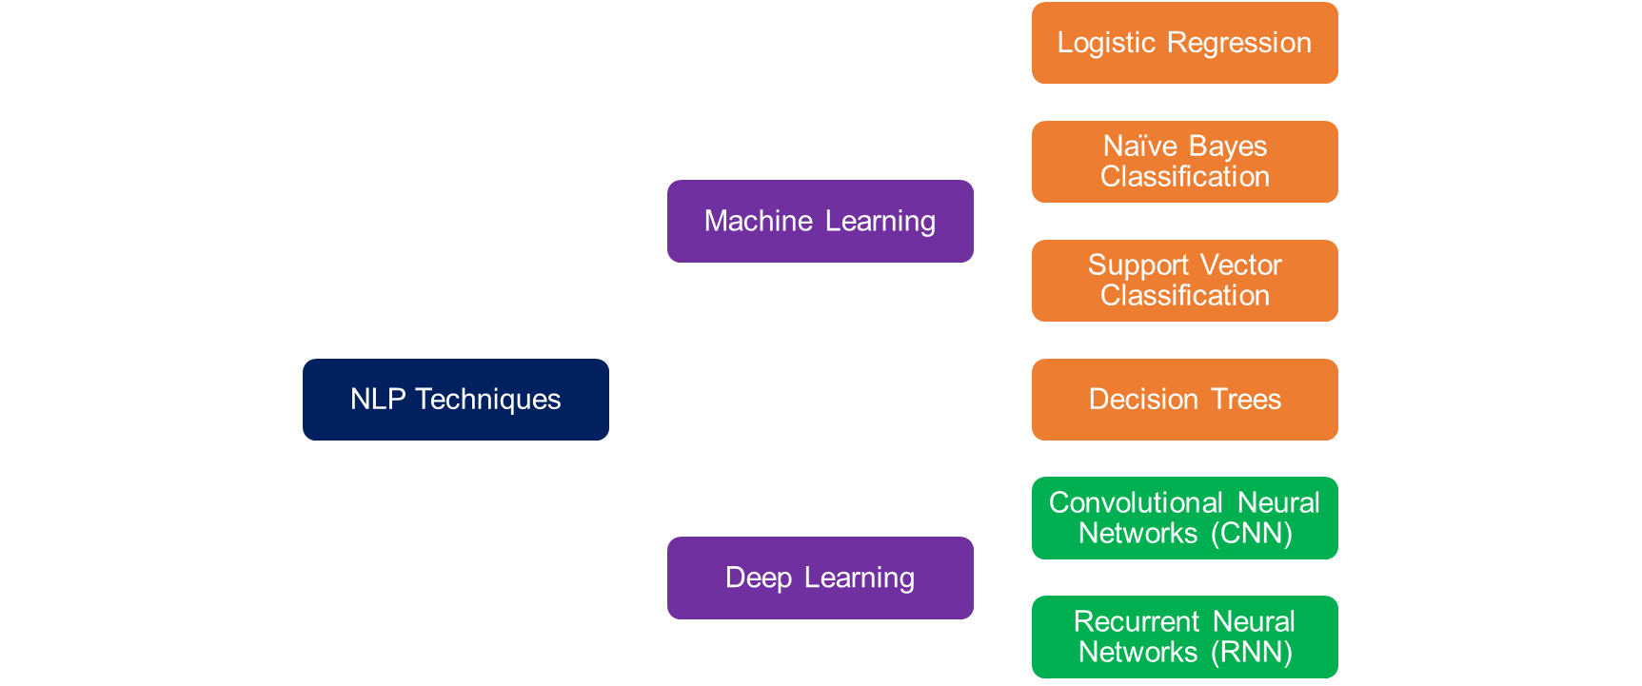
NLP Techniques
It was observed that logistic regression and Naïve Bayes model perform much better compared to other techniques in terms of speed and accuracy (~80%).
Linear SVM also yields high accuracy (~85%) but processing time is much longer.

Slide 15
Results
https://drive.google.com/drive/folders/1Dpf2jshoxms8ahnjqejPY9uKkTgf6bXy?usp=share_link

Slide 16
Challenges
It is important to note that sentiment analysis is not a foolproof method and the outputs may be affected by factors such as cultural differences, sarcasm, target audiences, and personal preferences or biases.
Moreover, these reviews are submitted by individual users whose opinions may or may not be representative of the general population.

Slide 17
Thank You!

